Slide 1

WEEK 5
25th SEPTEMBER–
29th SEPTEMBER
RUT CHOLERA
EMP CODE: 655095

Slide 2
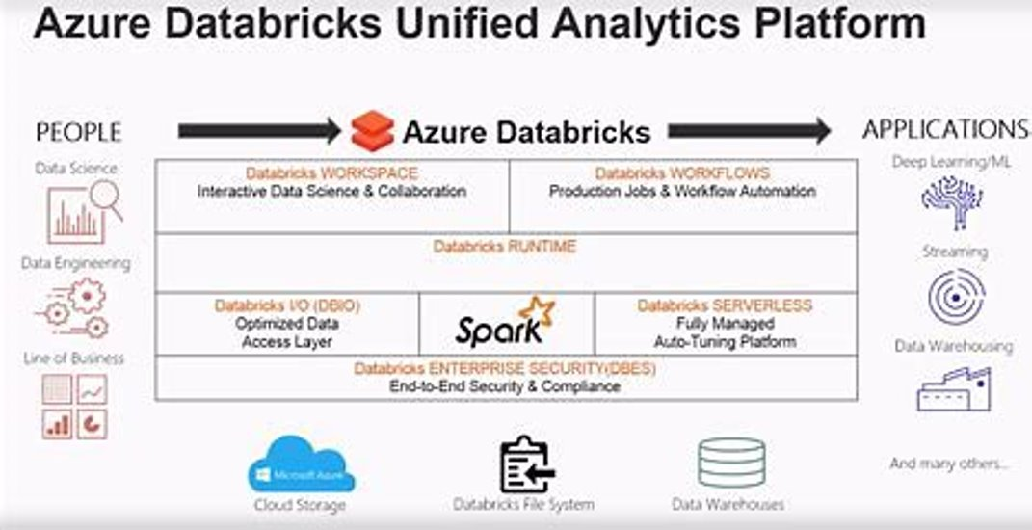
25th September
Databricks
Intro to databricks ,theory

Slide 3
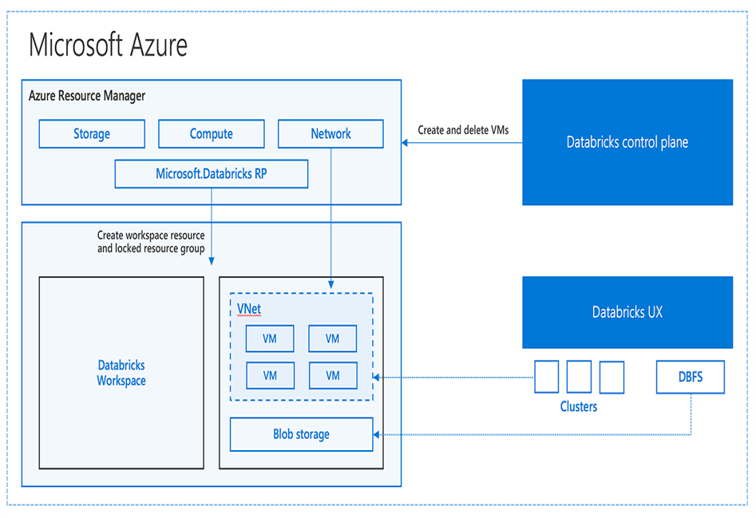
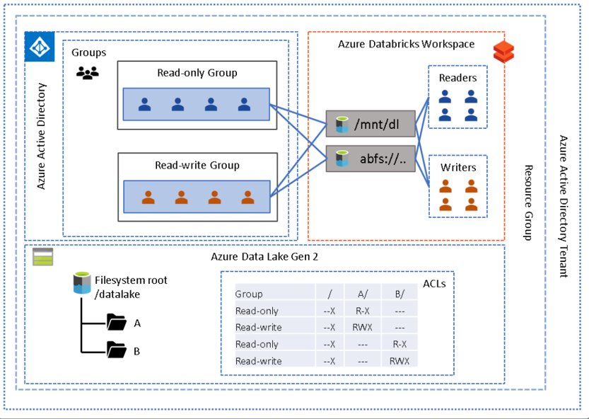
26th september
Databricks architecture
Mounting
Types of mounting

Slide 4
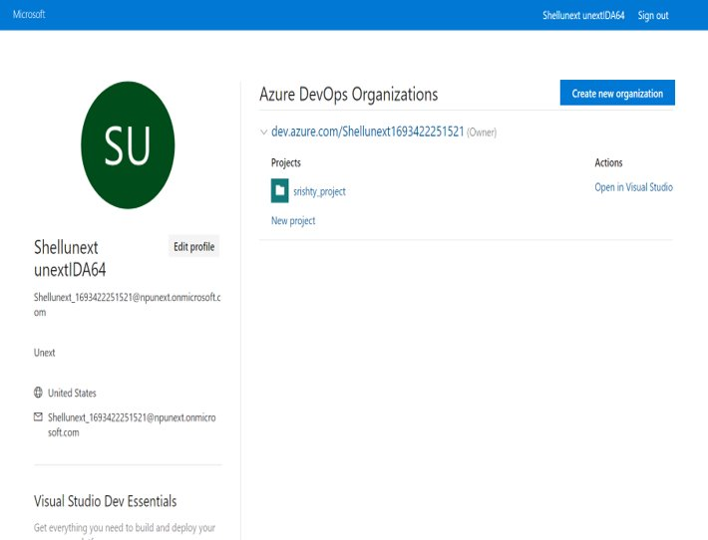
27th september
Azure devops
Introduction
Basics theory and little handson

Slide 5
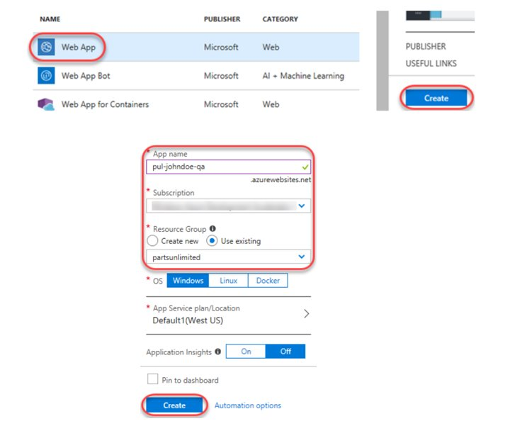
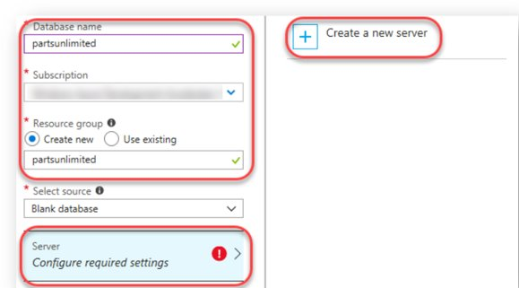
28th September
Azure devops continued online session
More handson

Slide 6
THANK YOU

